Slide 1
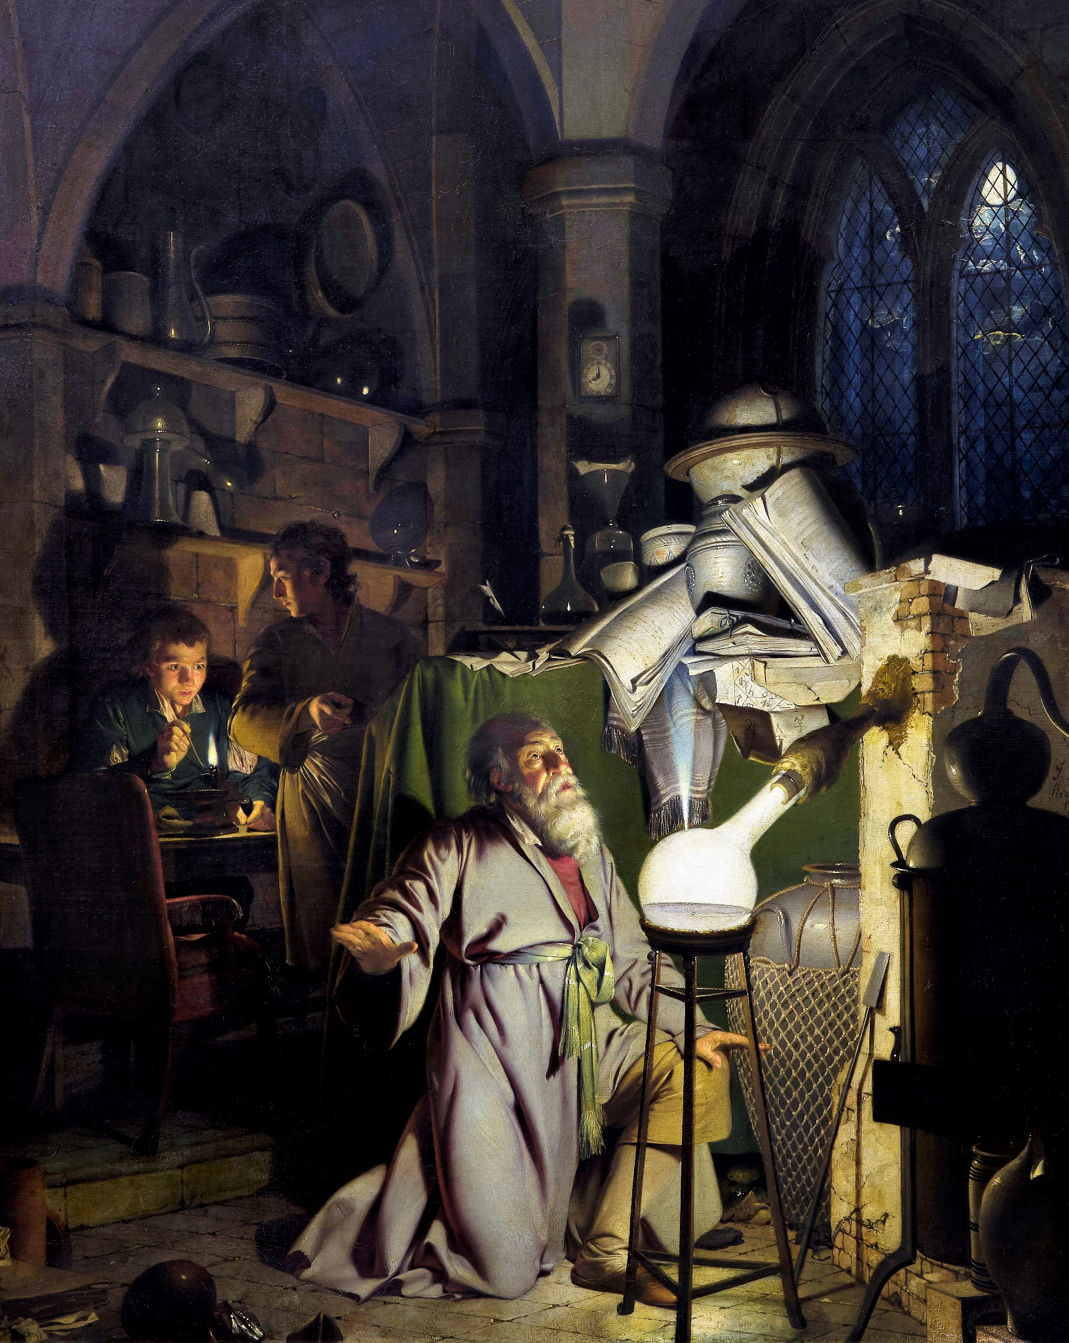

From a research question to research design
IL “Scientific Method and Analysis” WS 24-25
Kami Höferl
(Wright of Derby , Wikimedia, PD)
Notes:
"The Alchemist in Search of the Philosopher’s Stone" by Joseph Wright of Derby (1771)
substance capable of turning base metals such as mercury into gold or silver[
In this work, Wright captures an alchemist conducting an experiment with a crucible in search of the philosopher’s stone. The painting portrays a moment of discovery and highlights the experimental process central to early chemistry, before the formalization of modern science.

Slide 2
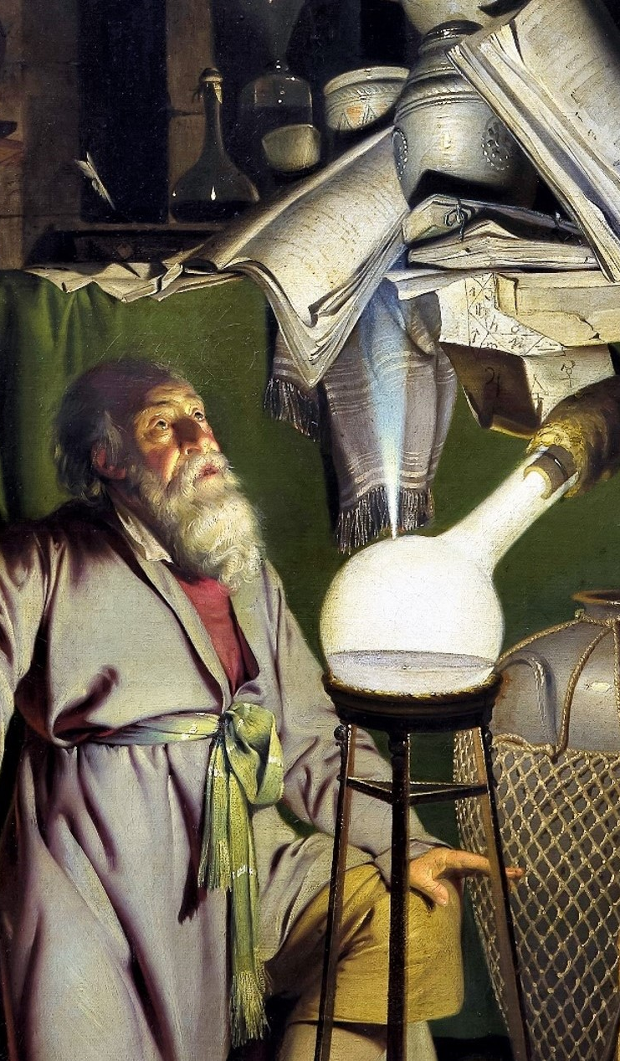
Overview
From a research aim …
… over objectives …
… to research design
What research methods are there?

Slide 3
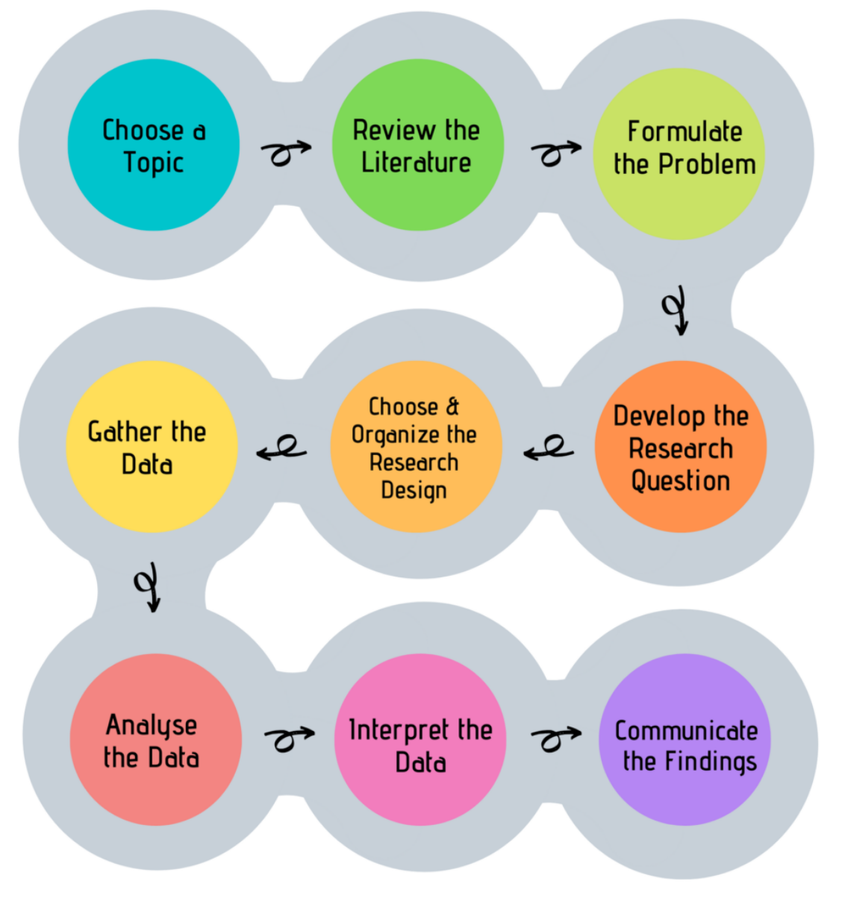
Look, Think, Test, Tell
👉 Main goal:
Understand scientific method

Slide 4
Digression: Your next steps
Aspect | Bachelor’s Thesis | Master’s Thesis
Purpose | Demonstrates foundational understanding of a field | Demonstrates advanced, in-depth knowledge & critical analysis
Scope | Narrow focus, often summarising existing knowledge | Broader scope with emphasis on original research or application
Depth of Research | Limited, often based on secondary data or a basic study | Extensive, with original research or detailed case studies
Complexity | Introduces concepts and methods of the discipline | Involves complex analysis, methodologies, & synthesis
Independence | Requires guidance from a supervisor | Greater independence; supervisor = advisor
Methodology | Basic application of research methods | Advanced or specialised research methods
Outcome | Demonstrates basic academic writing and understanding | Contributes to the field with new insights or applications
Evaluation Criteria | Focus on meeting basic academic standards | Evaluated on originality, depth, & contribution to knowledge
Audience | Primarily academic instructors | Broader, including specialists in the field

Slide 5
Questions, aims, and objectives

Slide 6
Look, Think, Test, Tell

Slide 7
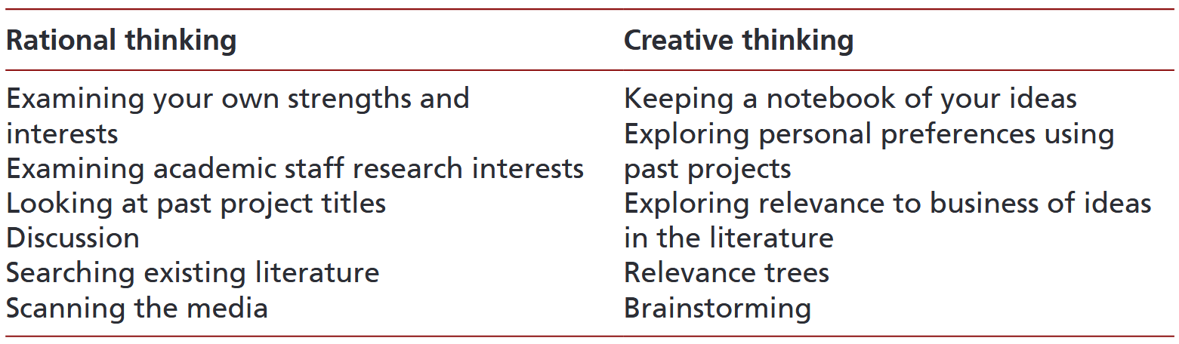
How to generate research ideas
Notes:
Exploring Personal Preferences:
1 What do you like in general about the project?
2 Why do you like the project?
3 Which ideas in the project appeal to you?

Slide 8
How to generate research ideas: Drill it down
Limit the reach:
Temporal
Geographically
By institution
By group of persons
According to sources
According to disciplinary history
According to theoretical approaches
According to representatives of a theory
According to "selected" aspect
…
Combinations possible
👉 Make the topic workable by asking specific question

Slide 9
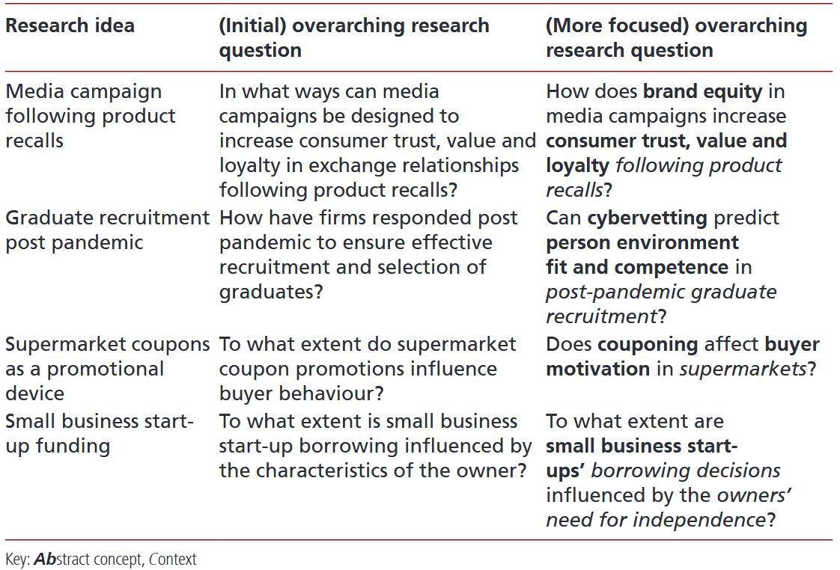
A) The AbC Rule for overall research questions / aims
Rule of thumb: Each research question / aim
One or two clearly stated Abstract concepts;
The Context in which the research is undertaken.
👉 Goal: WHAT is your research about?

Slide 10
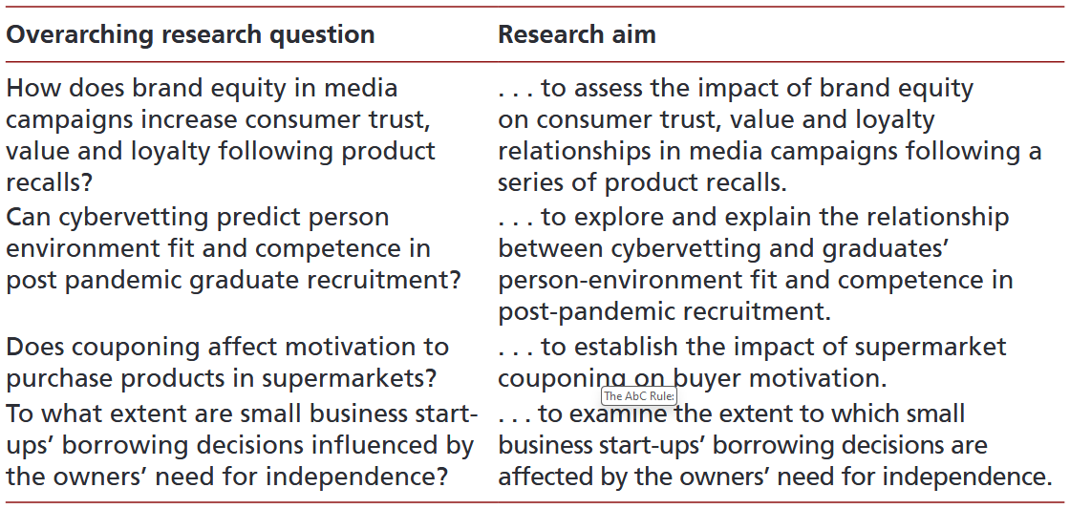
A) Overall research question or aim?
Research aim:
Brief statement (1 sentence)
Of the purpose of your research.
👉 can be derived from the overall research question:

Slide 11
A) Flashback: Research process & overall research questions / aims
Empirical research
Explorative research
Explanatory research
Descriptive research
Prognostic research
Evaluative research

Slide 12
A) Flashback: Research process & overall research questions / aims
👉 Building blocks: what, when, where, who, why, how, to what extent
Descriptive: What, where, etc.
What are the most common circular economy practices implemented by businesses in the European Union?
Exploratory: How, what
How are digital technologies (e.g., blockchain, IoT) being used to enable circular economy practices?
Explanatory: Why, how
How does consumer awareness influence the success of circular economy strategies in retail?
Evaluative: How
How effective are take-back schemes in achieving material recovery in the fashion industry?

Slide 13
B) From the overall research question / aim to research objectives
Aspect | Research Aim | Research Objectives
Definition | The overarching goal or purpose of the research. | Specific steps or tasks to achieve the aim.
Scope | Broad and general. | Narrow and focused.
Focus | Describes what the research intends to achieve. | Defines how the aim will be achieved.
Purpose | Provides the overall direction for the study. | Breaks down the aim into actionable components.
Number | Typically one main aim. | Multiple objectives to address different aspects of the aim.
Form | Written as a broad, aspirational statement. | Written as specific, measurable tasks.
Example | "To explore the impact of social media on academic performance." | - "To identify the types of social media platforms used by students." - "To assess the relationship between time spent on social media and grades."
👉 Goal: HOW will you reach your research aim?

Slide 14
B) From the overall research question / aim to research objectives
Overall aim:
The aim of this research is to evaluate employee engagement, commitment and development in a medium sized technology company and explore how these may be promoted following recent organisational change.
Overall question:
How have employee engagement, commitment and development been affected in a medium-sized technology company, and how may these be promoted following recent organisational change?

Slide 15
B) From the overall research aim/question to research objectives
👉 6 research objectives:
to describe the nature and cause of recent organisational change;
to define clearly the concepts used (employee engagement, employee commitment and employee development) to evaluate the impact of organisational change;
to evaluate the impact of recent organisational change on employee engagement and commitment;
to evaluate the impact of recent organisational change on employees’ perceptions about their scope for development and future progression;
to explore ways to promote employee engagement, commitment, development and progression following recent organisational change in the company;
to make recommendations to promote employee engagement, commitment, development and progression in the company.
1 Overall aim:
The aim of this research is to evaluate employee engagement, commitment and development in a medium sized technology company and explore how these may be promoted following recent organisational change.

Slide 16
B) Again: Dual perspective possible (objective/investigative question)
Research Objective | Research (investigative) Question
To describe the nature and cause of recent organisational change. | What are the nature and causes of the recent organisational change?
To define clearly the concepts used (employee engagement, employee commitment and employee development) to evaluate the impact of organisational change. | How are the concepts of employee engagement, commitment, and development defined in the context of organisational change?
To evaluate the impact of recent organisational change on employee engagement and commitment. | What has been the impact of recent organisational change on employee engagement and commitment?

Slide 17
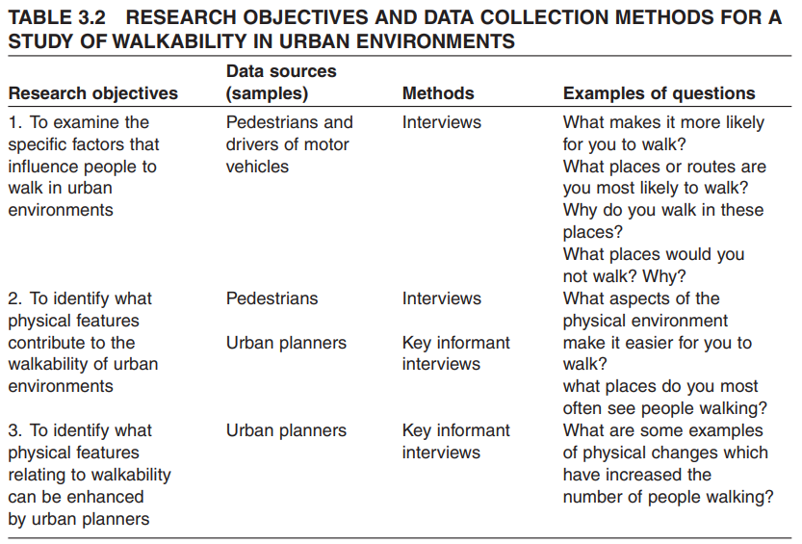
C) Why research objectives are not the end: Objectives = basis for further research design

Slide 18

From research aim to research design = non-linear process
Overall research aim/question
Research objectives/investigative questions
Research design

Slide 19
The greater picture:
Overall research aim/question
Research objectives/investigative questions
Research design

Slide 20
Digression: All this for a seminar paper?
👉 Aims of seminar papers during your bachelor studies:
Develop Academic Writing Skills
Learn structure, argumentation, and referencing
Strengthen Research Abilities
Search, evaluate, and synthesise scholarly sources
Deepen Subject Knowledge
Explore topics beyond lectures and understand key concepts
Encourage Critical Thinking
Analyse and compare perspectives, develop evidence-based opinions
Practice Time Management
Plan, organise, and complete a project on schedule
Prepare for Advanced Academic Work
Build skills for thesis writing and research projects

Slide 21
Digression: Workflow for a seminar paper
👉 Open topic: Generate overall aim of paper
Overall aims
Explaining a phenomenon
Explain theories & positions
Systematise subject area
Check assertions
Discuss arguments for/against a position
Historical development of a phenomenon
…

Slide 22
Digression: Workflow for a seminar paper
👉 break overall aim down to objectives
Examples: fictional seminar topic
"Circular Practices in the Construction Sector: A Case Study Approach"
"Barriers to Implementing Circular Principles in Emerging Economies"
"The Role of Local Governments in Supporting Circular Initiatives"

Slide 23
Digression: Workflow for a seminar paper
Example: "Circular Practices in the Construction Sector: A Case Study Approach“
Define the concepts used:
Circular practices & construction sector
Provide an ovierview on circular practices that a) are theoretically suitable and/or b) have already been implemented in the sector
Explain why the chosen case study is a suitable one
Explain which practices have & have not been implemented in your cast study
…

Slide 24
Research design

Slide 25
Look, Think, Test, Tell

Slide 26
C) Why research objectives are not the end: Objectives = basis for further research design

Slide 27
What methods are there?
👉 Methodology = study and application of appropriate methods, processes, and frameworks used to answer research questions or test hypotheses
Elements:
Research approach: Qualitative, quantitative & combinations
Methods: specific tools
Philosophical assumptions: underlying principles
Data analysis: Procedures for examining & interpreting data

Slide 28

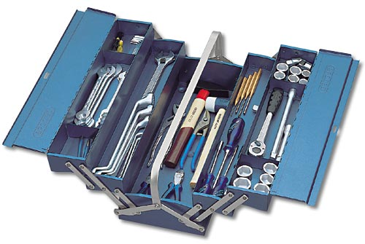

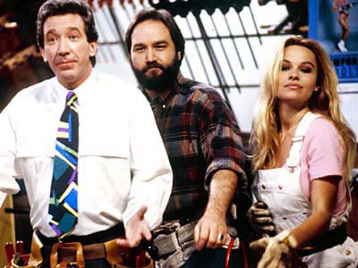
What methods are there?

Slide 29
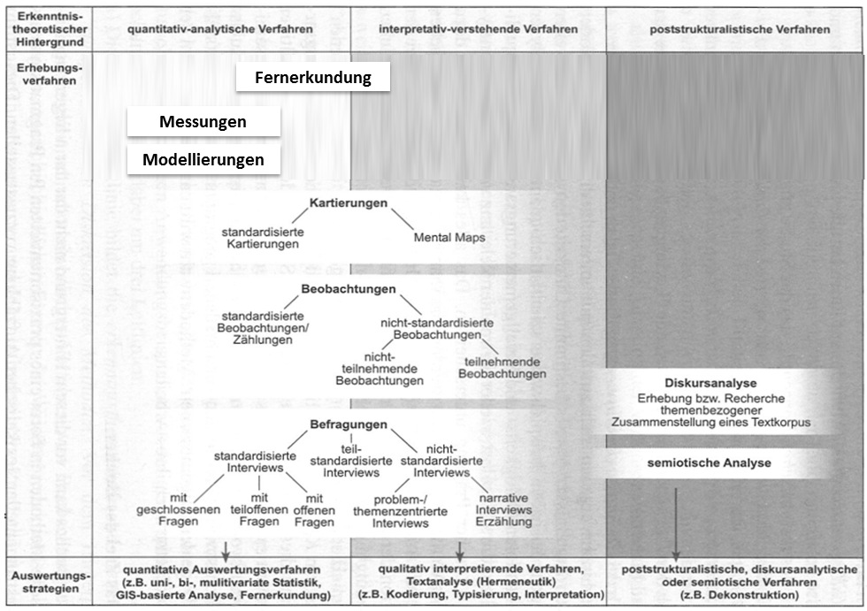
What methods are there? An Overview

Slide 30

As always:

Slide 31
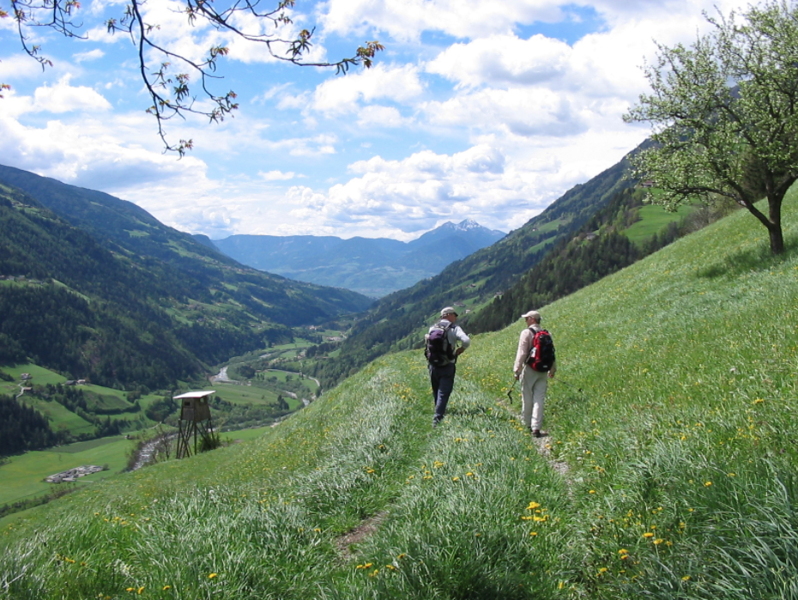
Assumption: You can measure whatever interests you
Feature carriers
Characteristics of interest
👉 Objective:
compressed, abstract representation of reality

Slide 32
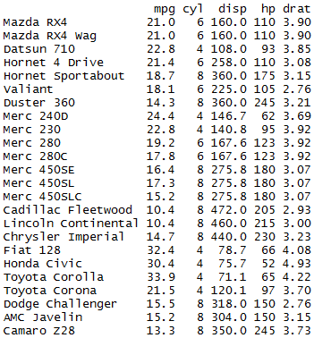
Assumption: You can measure whatever interests you
Measurement = assignment of
a) characteristic values*
b) of characteristic carriers
c) to the characteristic dimensions to be observed.
* coded using number

Slide 33
Assumption: You can measure whatever interests you
Variable:
symbol for the set of characteristics of a feature (in a group of characteristic carriers)
👉 Assignment of feature & characteristics
Assignments should:
Disjunctive: mutually exclusive
Exhaustive: possible characteristics known & assigned

Slide 34
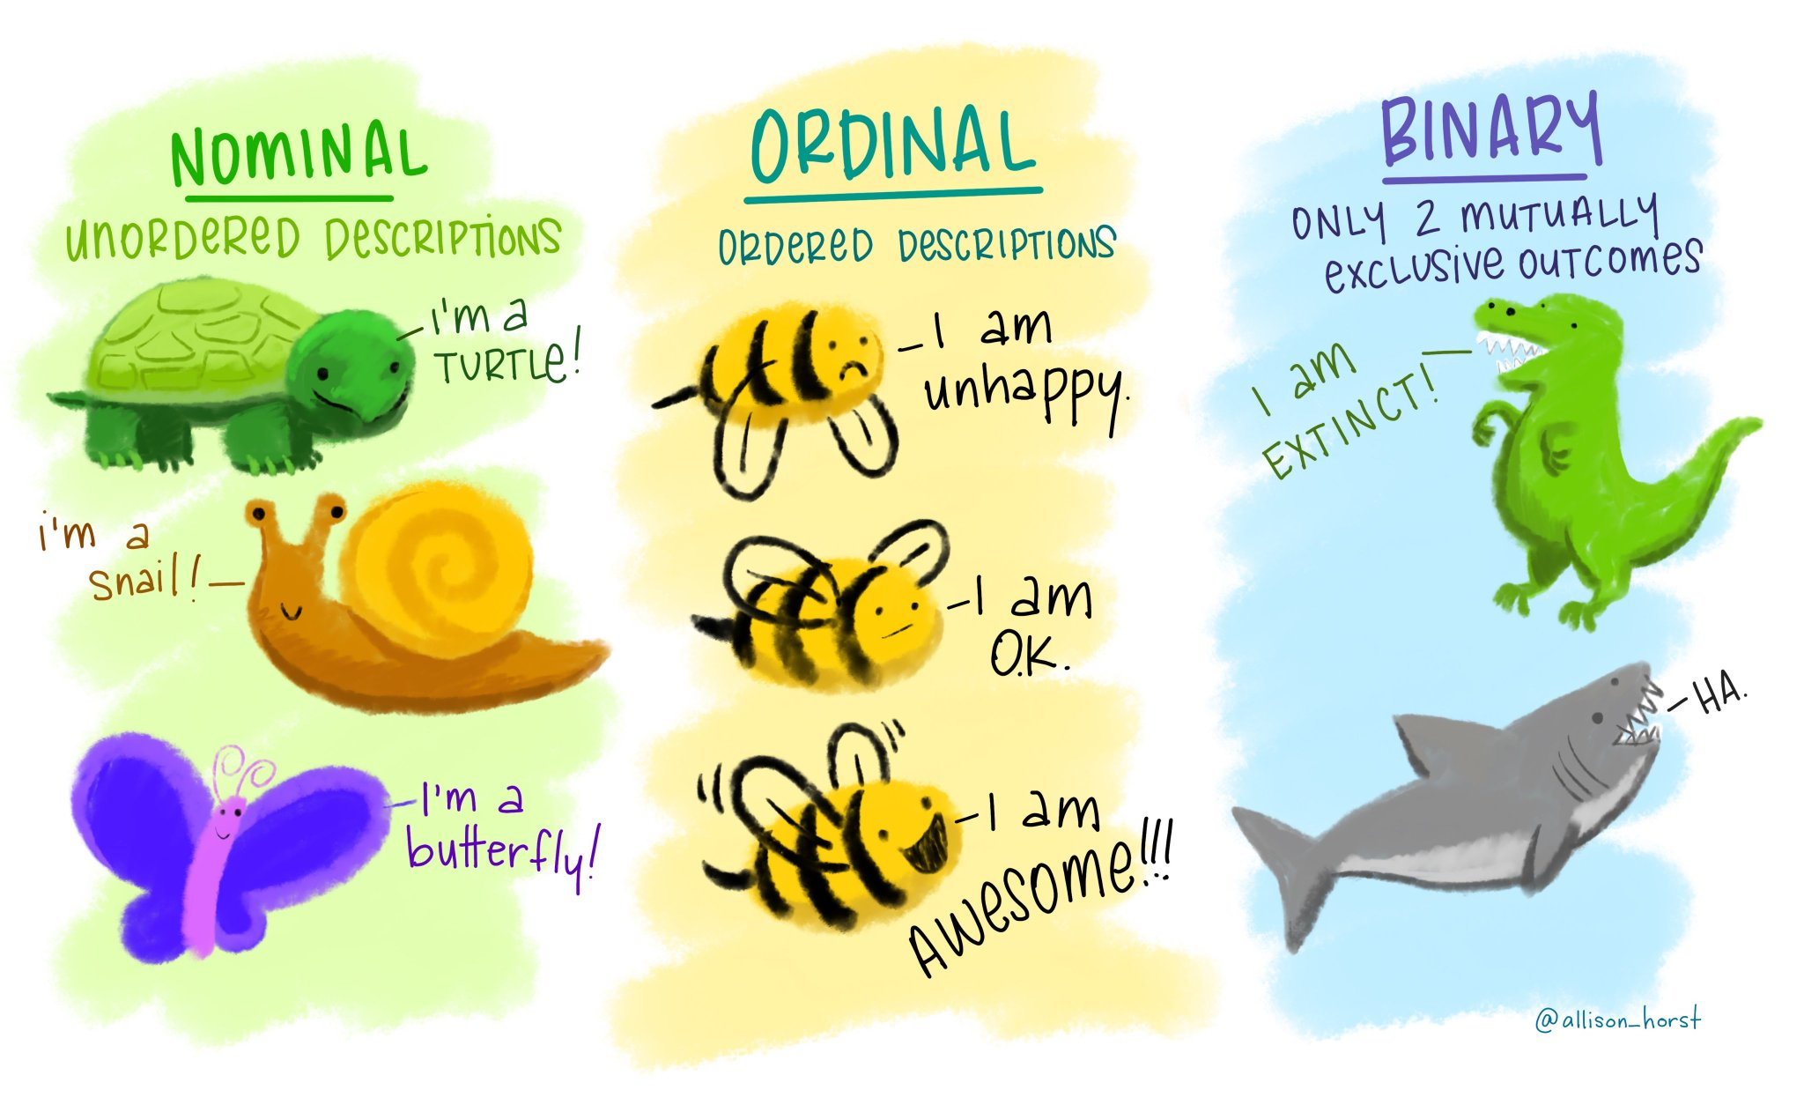
Digression: Numbers ≠ Numbers

Slide 35
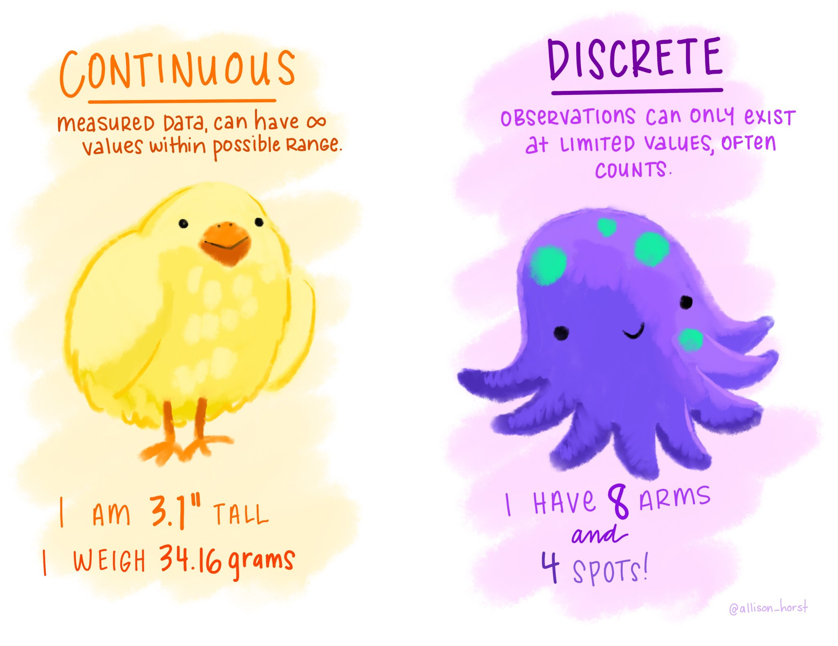
Digression: Numbers ≠ Numbers

Slide 36
Assumption: You can measure whatever interests you
Advantages:
(more or less) reliable comparison of the properties of objects
Disadvantages: Social reality & "objective" data
Complex social phenomena:
Extensive process of "making measurable“ 👉 Operationalisation
Varying definitions & operationalisations
Cutting through "smooth" transitions

Slide 37
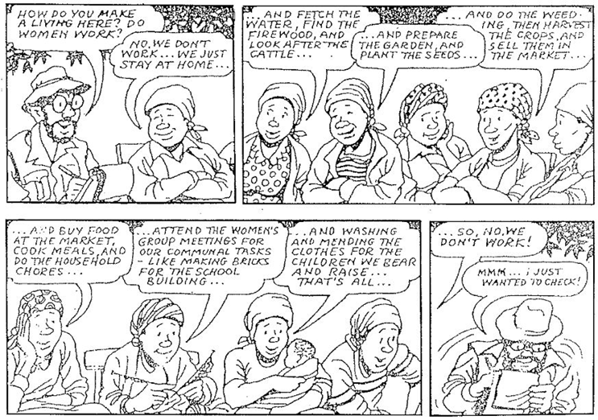
Assumption: You can measure whatever interests you @ complex social phenomena

Slide 38
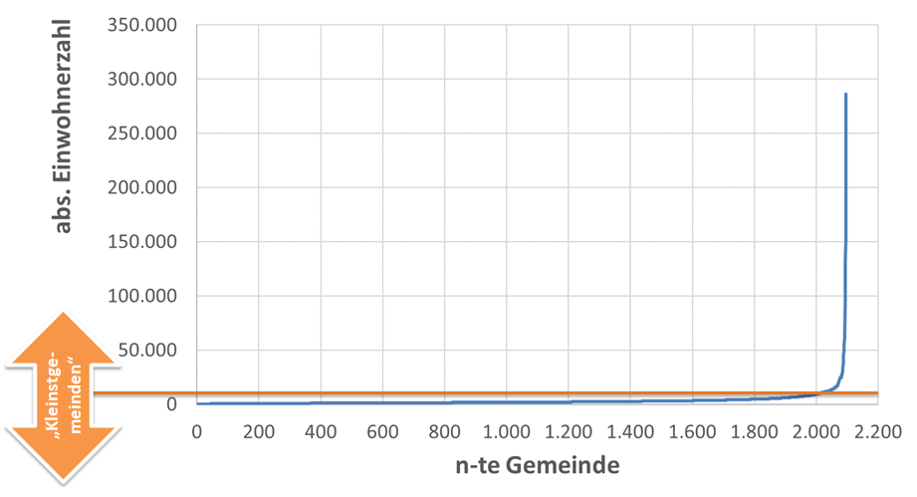
Assumption: You can measure whatever interests you @ cut through “smooth” transitions

Slide 39
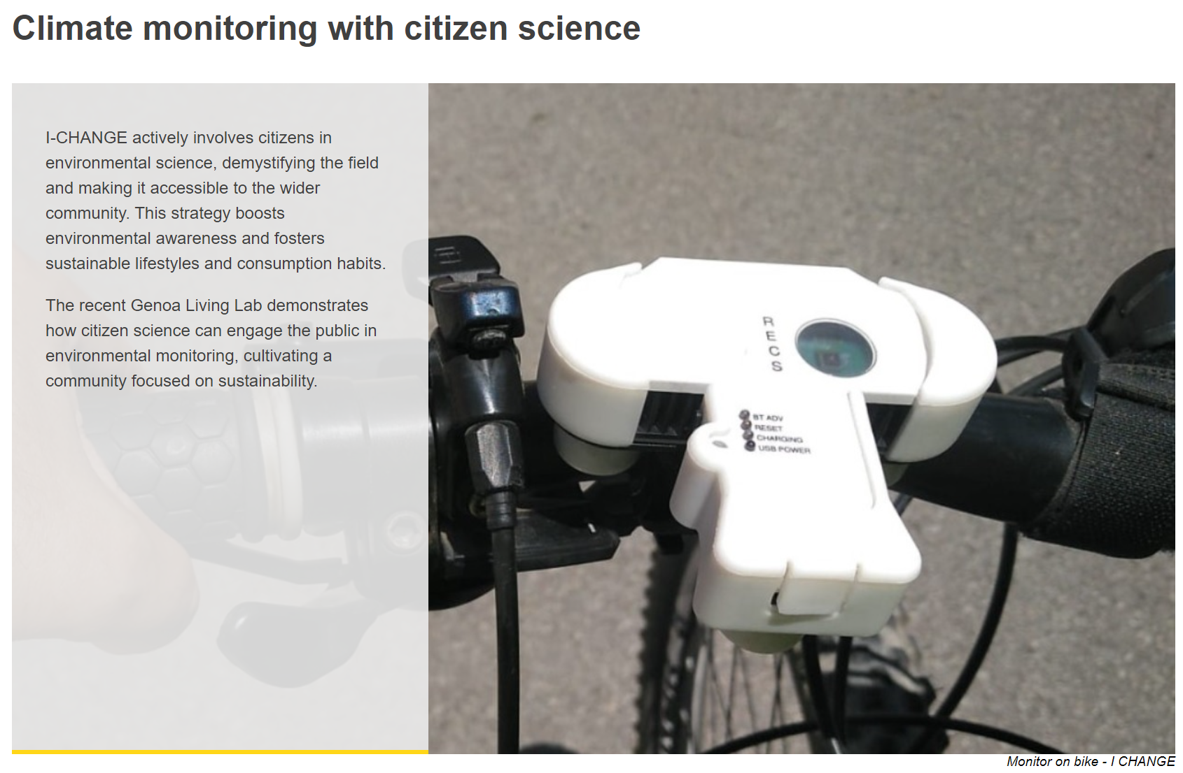
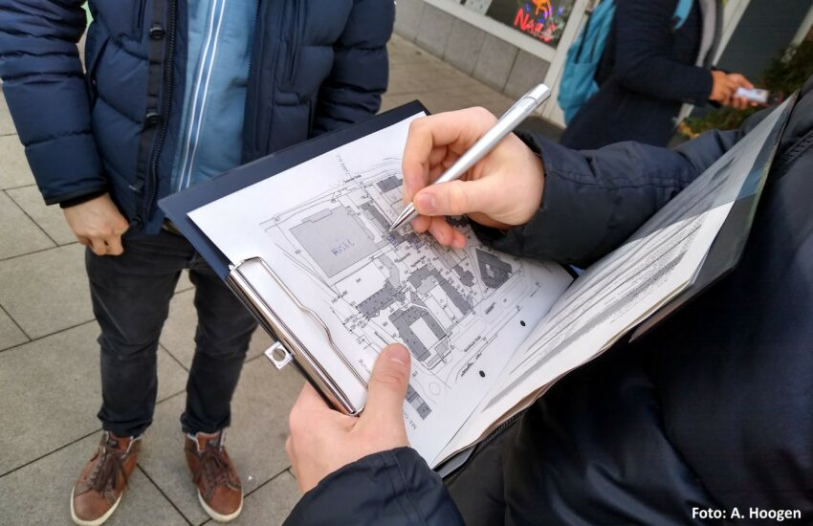
What methods are there? Quantitative Mappings

Slide 40
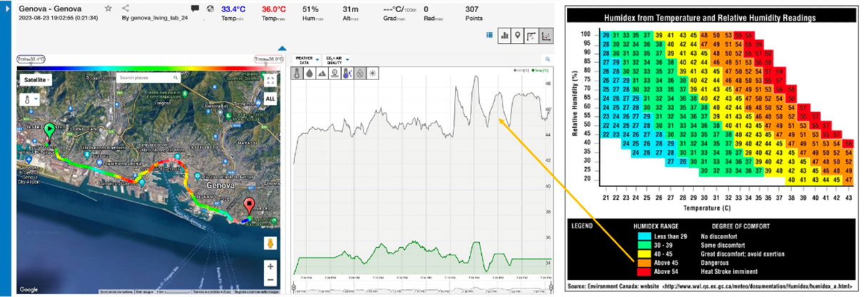
What methods are there? Quantitative Mappings

Slide 41
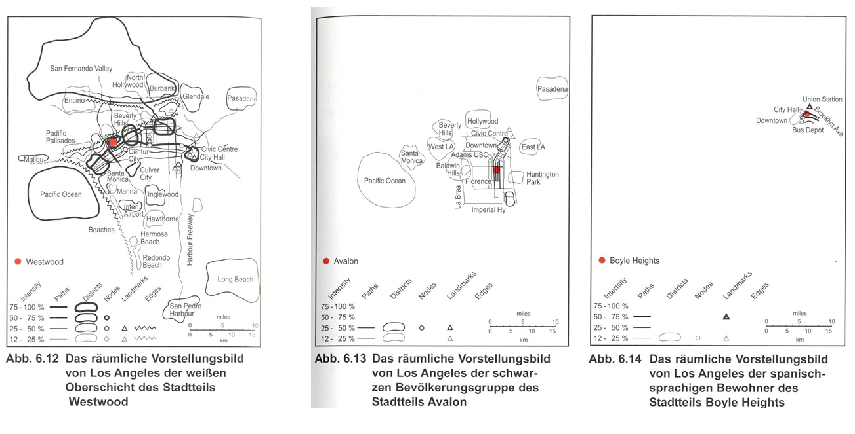
What methods are there? Qualitative Mappings “Mental Maps”

Slide 42
What methods are there? An Overview

Slide 43
What methods are there? Observations
Scientific (systematic) observation methods:
Serve a clear research purpose
Systematically planned (→ not a product of chance)
Systematically documented and analysed
Repeatedly checked for validity, reliability, and accuracy
Aim of observations: Recording and interpretation of
Human behaviour (verbal - non-verbal) &amp; consequences
Social characteristics (vehicle type, clothing etc.)
Coagulated behaviour (displays, garden designs etc.)
…

Slide 44
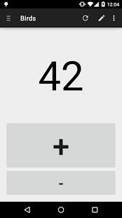
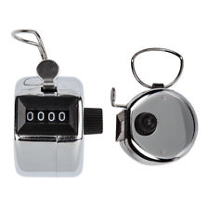
What methods are there? Quantitative Observations
Systematic observation & quantitative Registration of "relevant" facts

Slide 45
What methods are there? Types of Observations
Overt/covert observation
Knowledge of the observed about their observation
Participant/non-participant observation
Non-participant: observer = silent recorder
Participatory: Communication and participation in (inter-)actions
Structured/unstructured observation
Structured: Observation scheme (=systematic inventory of observation content) is available
Unstructured: spontaneous interest determines what is observed

Slide 46
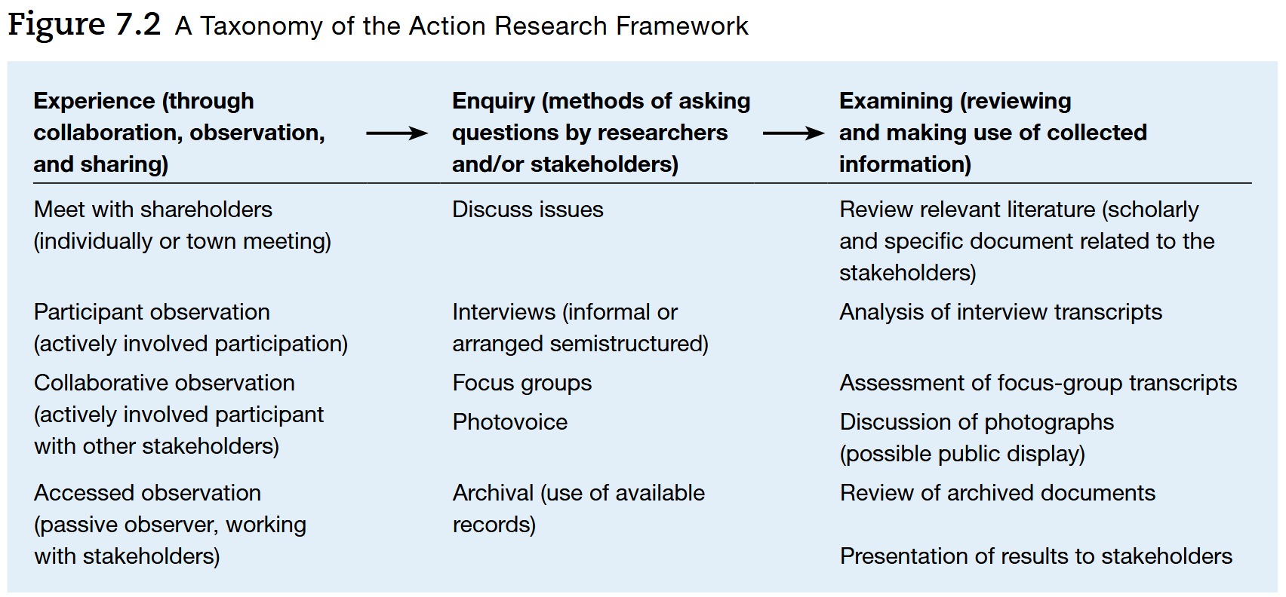
What methods are there? Qualitative Observations

Slide 47
What methods are there? An Overview

Slide 48
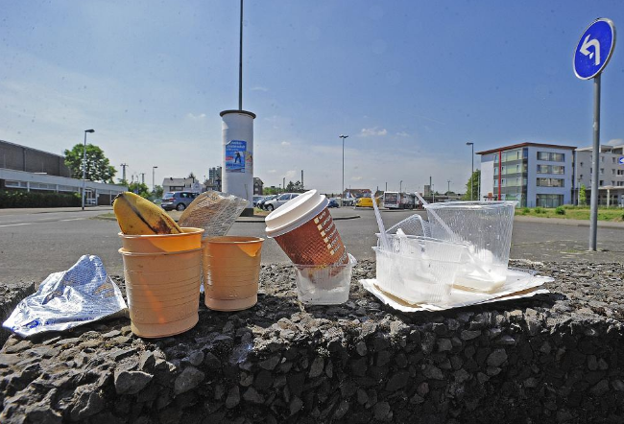
What methods are there? Non-reactive approaches
Collective term:
No influence (= contact) on the persons, events or processes analysed
Because data collection is not noticed
Because researchers focus on behavioural artefacts
👉 Actually: special form of observation
Indirect observation: reconstructing experience, behaviour etc. from documents, traces, residues etc.

Slide 49
What methods are there? Non-reactive approaches
Possible data sources:
Traces of behaviour:
Traces of use, graffiti, marginal notes, rubbish composition
Signs, notice boards, house rules
Books, journals & newspapers (online: comments)
Online media: Facebook, Twitter etc.
Symbols: stickers, badges, buttons
Archives & directories: systematically generated text material
Minutes (state parliament, municipal council, etc.), registers, comments on draft laws, etc.
Individual documents: diaries, correspondence, pictures
…

Slide 50
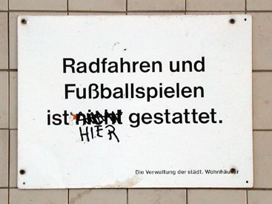
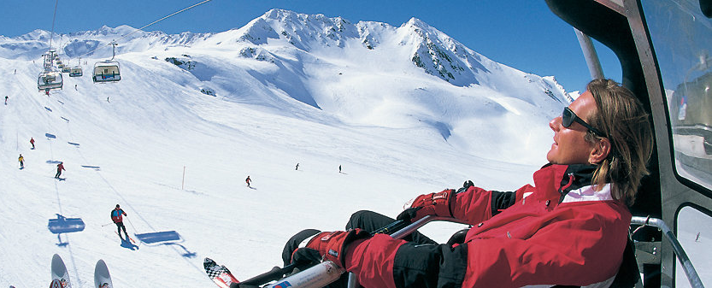
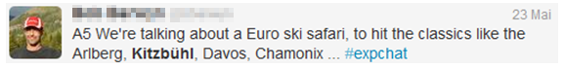
What methods are there? Non-reactive approaches

Slide 51
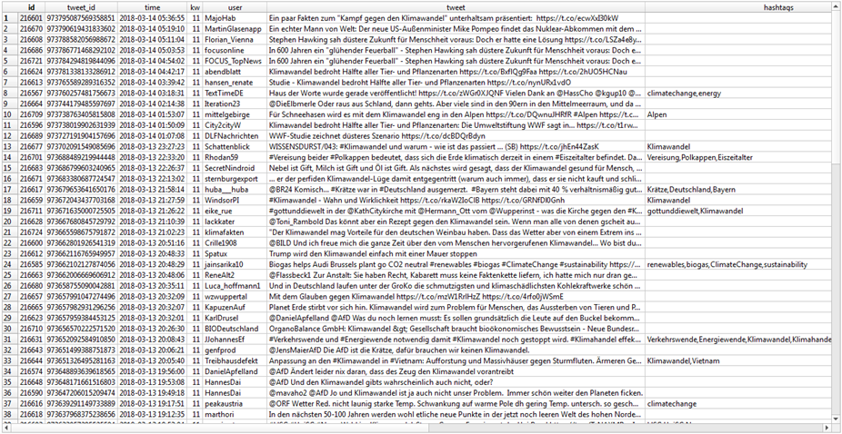
What methods are there? Non-reactive approaches Climate Change & Twitter

Slide 52
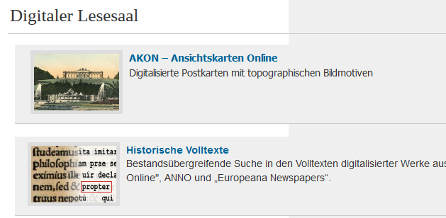
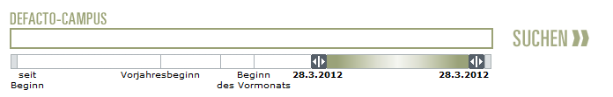
What methods are there? Non-reactive approaches
👉 Goal: corpus creation
Access via repositories:
Libraries & Archives
Newspapers & TV
BSP: APA DeFacto Campus
Archives of institutions:
State parliaments, parliaments
State & local administrations
Image databases
Limited "direct" access:
Social media (Facebook, Twitter etc.) → Software or customised cod

Slide 53
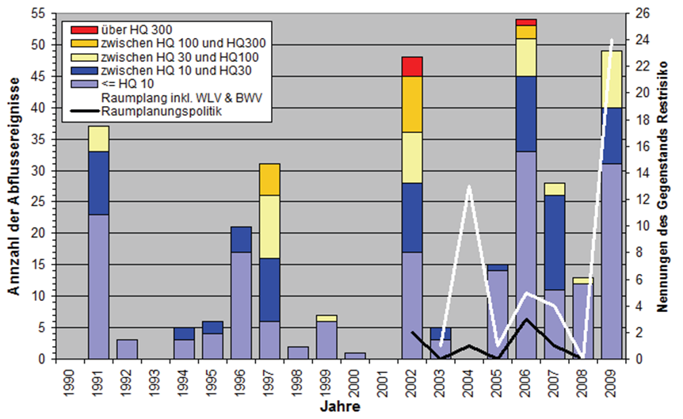
What methods are there? Non-reactive approaches

Slide 54
What methods are there? An Overview

Slide 55
What methods are there? Quantitative Surveys
👉 classic approach to data collection in social science
Collection of facts, opinions, knowledge, attitudes & evaluations
→ Systematically controlled communication between people
However, not all surveys are the same:
Form of the survey:
Oral in person - written - telephone - online
According to the degree of standardisation:
Fully, partially & non-standardised survey
According to the type of questions asked:
Closed, partially open & open question

Slide 56
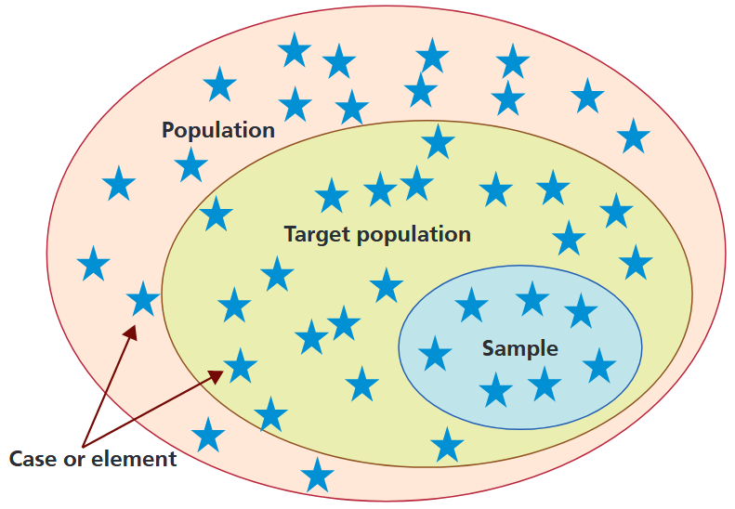
What methods are there? Quantitative Surveys
"Representative":
every element of the population → equal chance of being included in the sample
👉 structural equality = frequency distribution of "important" characteristics in the population exactly reproduced
Prerequisite for drawing conclusions about the population (e.g. ranges)

Slide 57
What methods are there? Quantitative Surveys
👉 The opposite:
The "informative" sample
No inference to the population

Slide 58
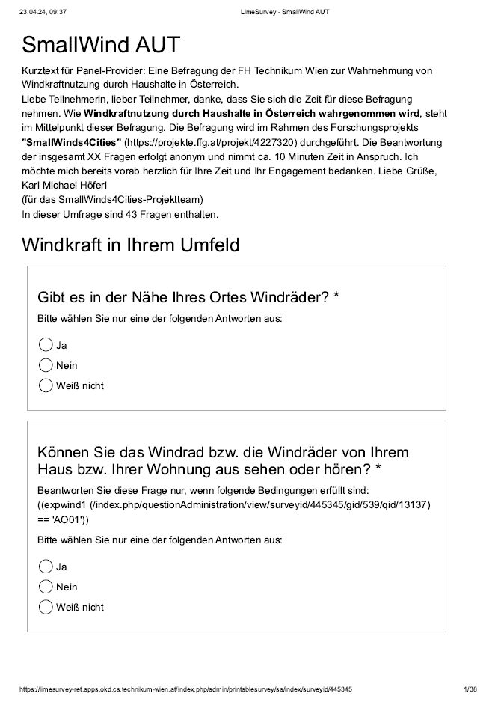
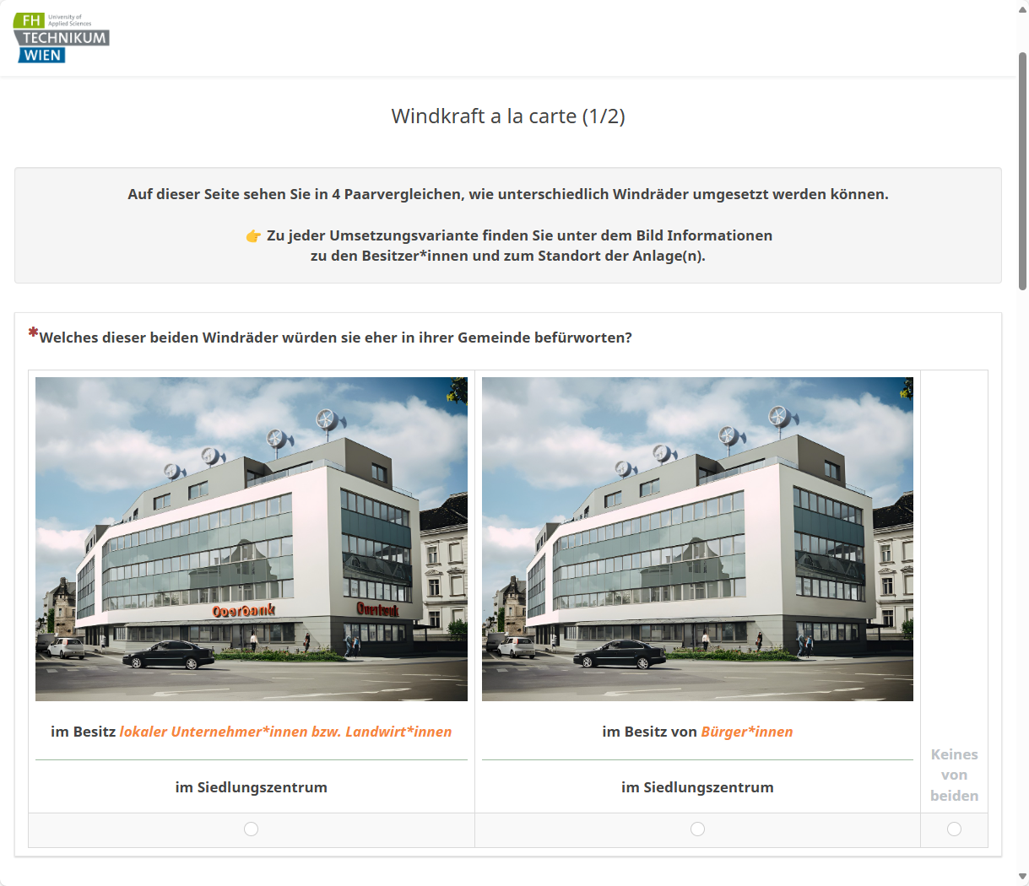
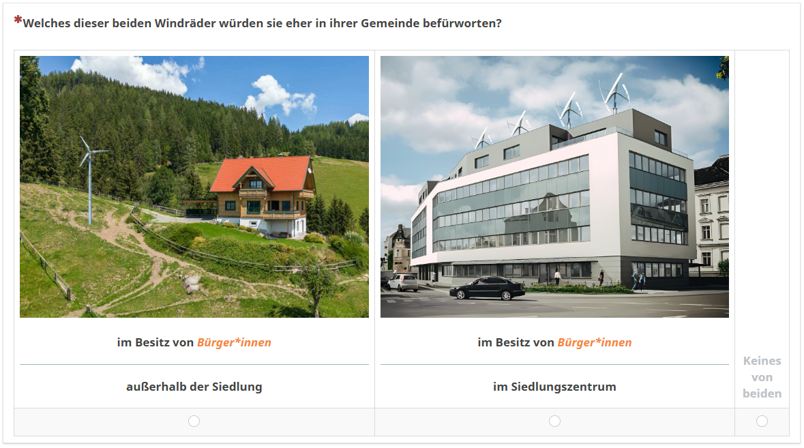
What methods are there? Quantitative Surveys

Slide 59
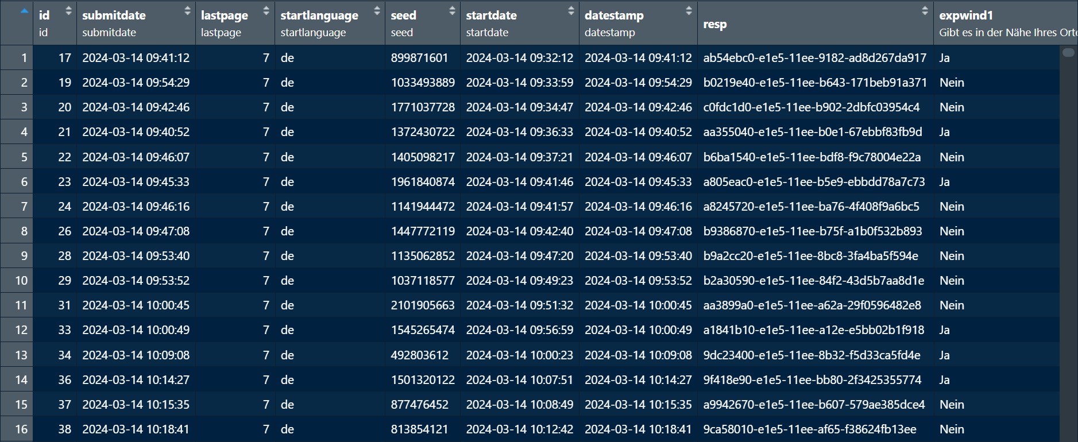
What methods are there? Quantitative Surveys

Slide 60
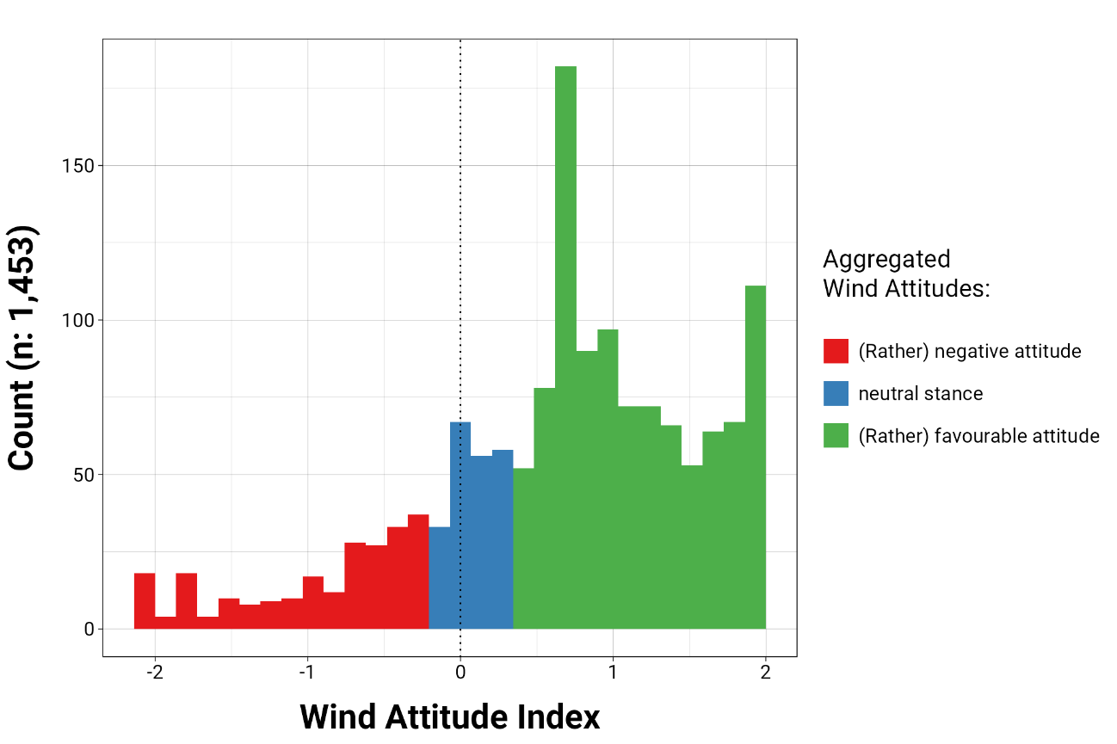
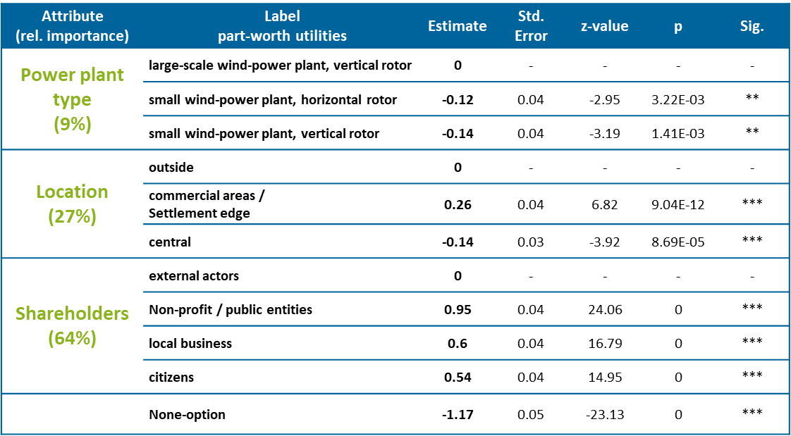
What methods are there? Quantitative Surveys

Slide 61
What methods are there? An Overview

Slide 62
What methods are there? Qualitative Interviews
“Quality refers to the what, how, when, where, and why of a thing—its essence and ambience. Qualitative research, thus, refers to the meanings, concepts, definitions, characteristics, metaphors, symbols, and descriptions of things.” (Berg & Lune, 2017:12)

Slide 63
What methods are there? Qualitative Interviews
Qualitative data:
non-numerical information:
descriptive, textual, or visual
that captures the qualities, meanings, and experiences of a subject
👉 in depth understanding of concepts, behaviours, or social phenomena

Slide 64
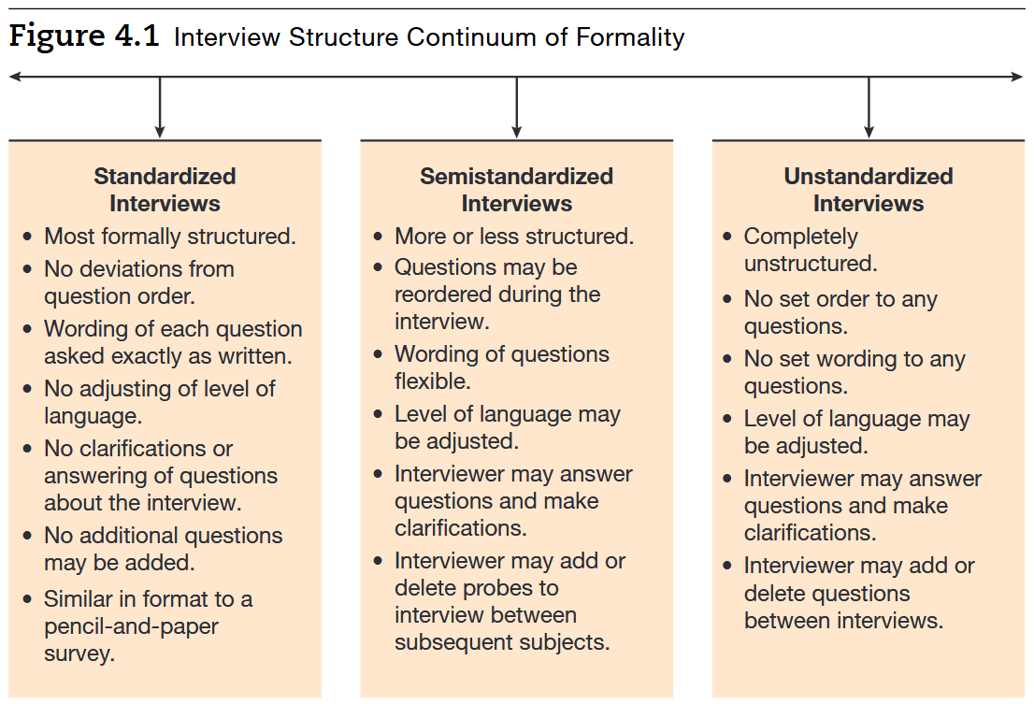
What methods are there? Qualitative Interviews
👉 Interviews = one way to gather qualitative data:

Slide 65
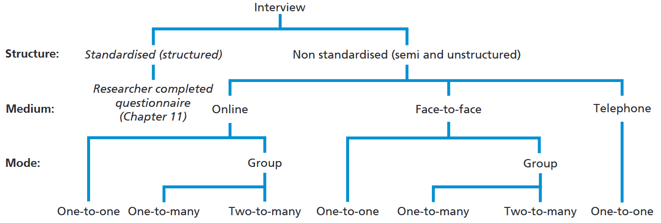
What methods are there? Qualitative Interviews

Slide 66
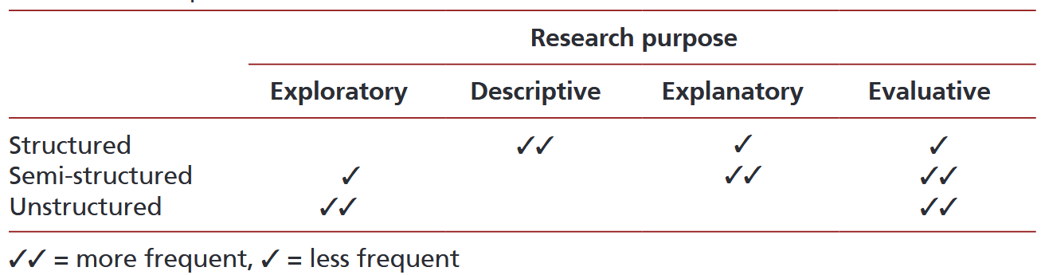
What methods are there? Qualitative Interviews

Slide 67
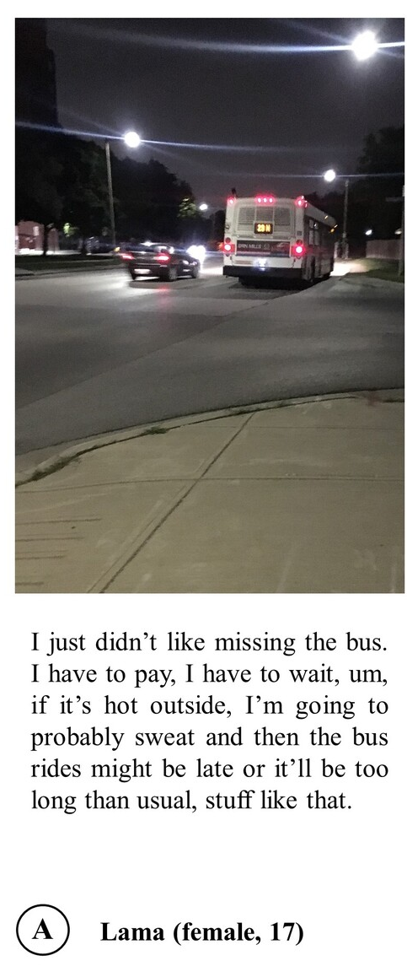
What methods are there? Qualitative Interviews
Interviews = one way to gather qualitative data
Alternatives:
Diaries
Photovoice
Social media 👉 non-reactive approaches
...

Slide 68
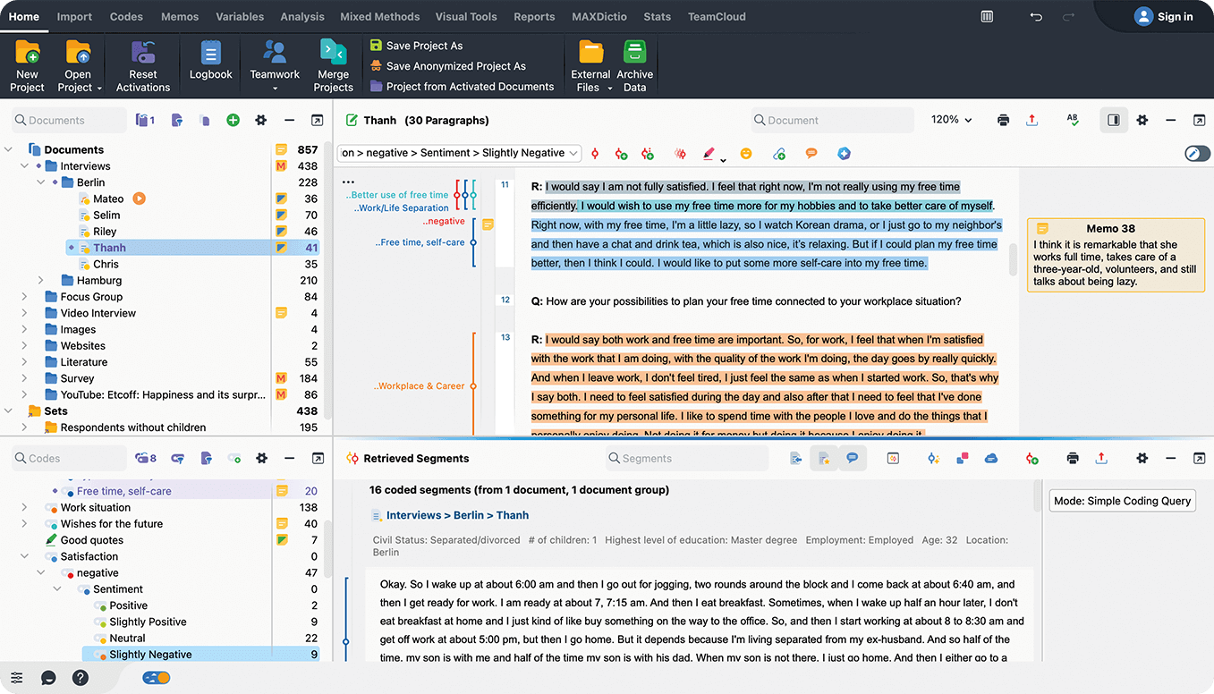
What methods are there? Organising & analysing qualitative data

Slide 69
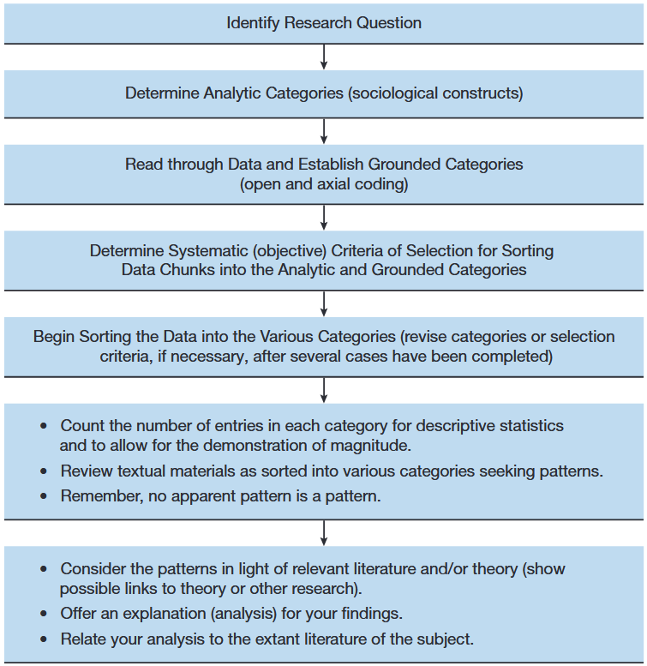
What methods are there? Qualitative Interviews & their analysis
A) Qualitative content analysis:
Systematic method to analyse and interpret communication content.
texts, images, or media
Identifies patterns, themes, or meanings
Involves coding and categorising data

Slide 70
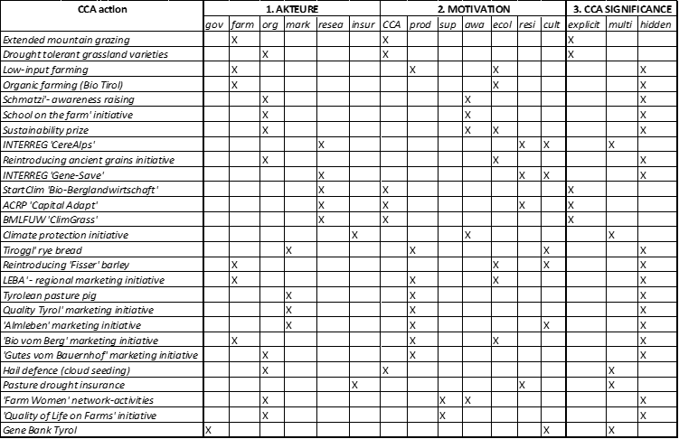
What methods are there? Qualitative Interviews & their analysis

Slide 71
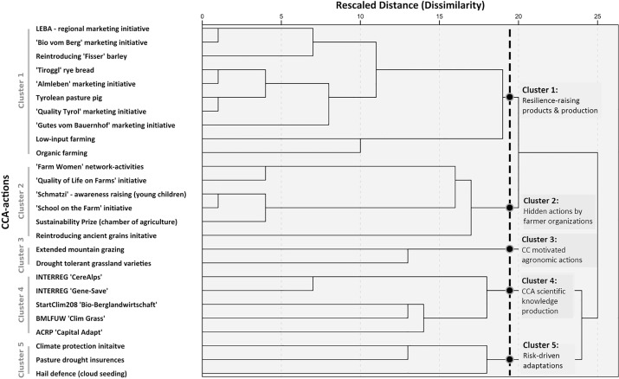
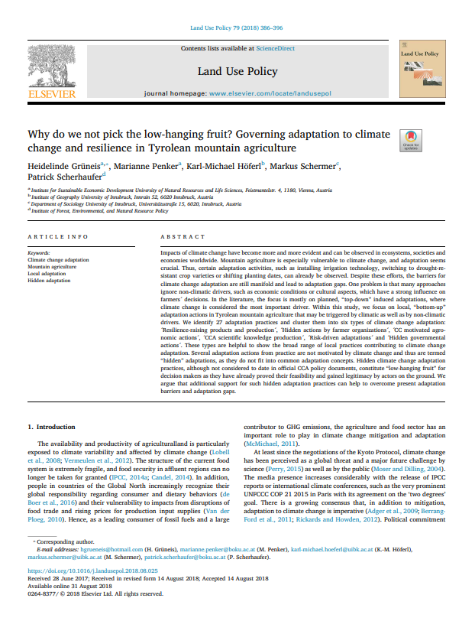
What methods are there? Qualitative Interviews & their analysis

Slide 72
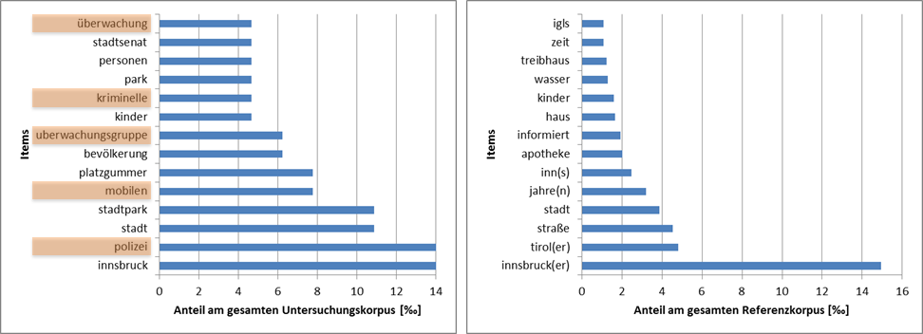
What methods are there? Qualitative Interviews & their analysis
B) Quantitative content analysis:
Assignment of text to categories that are operationalisations of features of interest
👉 Word material is counted with regard to certain "interesting" aspect

Slide 73
Wrap it up

Slide 74
Wrap it up
XXX

Slide 75
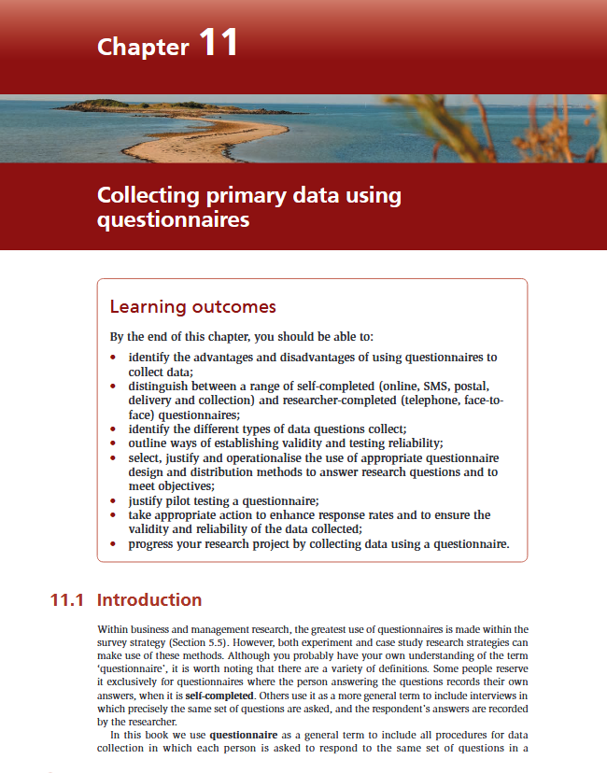
Till next session:
Chapters 11.2 & 11.5 on questionnaires from Saunders et al. (2023)

Slide 76
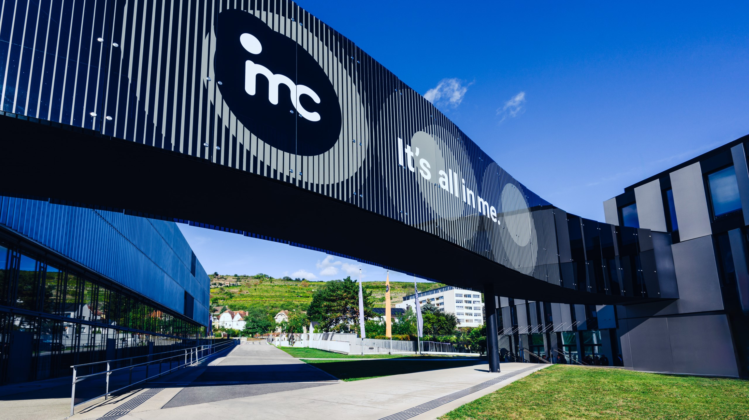
So long & cheerio!

